Slide 1

JOYNET MARKETing
Pitch Deck
Technology project for social marketing
Making new things in marketing
Joynet Business 2025
Make new things in Marketing | Pitch deck
Feb 2025

Slide 2

Project
Target and vision
Through this project , we aim to be a Proven -Technology Owners in the field of digital marketing & e-business , doing our best to deliver the best commercial dedicated product,
In success that we hope together , we continue to develop more products and services based on this technology .
Thanks always for your corporation of any kind supporting our vision.
Eng. Husam Hamdeh
Make new things in marketing
Fav 2025

Slide 3
Table of contents
02
03
04
05
Problem vs solution
Product overview
Market & competition
Business model
01
JN Technology
Joynet Marketing | Pitch deck
Feb 2025

Slide 4
01-JN Marketing Technology
Finding Inspiration in Every Turn
Cloud Sharing
Business & Marketing
Consider a module were we have a large collection of business services saved (hosted)in a simple organized database in post-like form, presented in website – page (1 screen ) , and this database is being promoted to social media, google Ads, through the net with traffic-apps ,
Were Marketing this database means marketing of all included services at once , and getting more traffic to this page , a business - communication will also be established as visitors accessing this services would contact directly the providers.
In return having a large traffic to website would open a many ways to get revenues for us . Starting with subscriptions .
Joynet Marketing | Pitch deck
2025

Slide 5





Module Design
Web Hosting
Promotion
Business
Organized Services Database
Joynet Marketing | Pitch deck
Fab 2025

Slide 6
Business plans
A- Hot-Offers Station
Inviting business to participate in the project in a way to keep adding special ads , hot offers and announcements , in a way to make Joynet becomes a reference for following this offers and the special ads , generating a good large traffic to web site , so we will have 3 basic plans in relation with business
1- Normal : business just adds posts and may get use of website-group discussion and make online business as interface with customers , being asked to pay for subscriptions in the right project stage .
2- Promoter : business ask to special promotion in the site or over the net , and this is paid .
3- Business Partner : business offers sales commotions getting extensive promotions and care from the site in all ways .supporting even a dedicated order online system .
Fab 2025
Joynet Marketing | Pitch deck

Slide 7
1- Introduction
Technical discussion
MERGING Social Media and Database technologies into one , creating simple database having records as social posts , with certain attributes Fields defined as post specs just like database attributes exactly ,this attributes used as Filters to switch between records . User see related posts when apply related filters .
So we can search and modify posts so easily in very fast way , this helps mostly for business and marketing approaches ,getting the fastest communication between customer and business , mainly used for Hot Offers platform , Business Announcements ,News , Updates ,advertise of many business services at once, easy and effective following business by customers .
Joynet Marketing | Pitch deck
2025

Slide 8

Technical discussion
All done in one screen...
Approaches
AI shopping for products and services of any niche- type
Social media coverage , post to groups , communities, networks
Fast -Deals Communication for business
Technology-Methods
Technical discussion
Post ( discussions / shopping -offers/ promotions) is targeted & shared automatically to interesting readers
Browse directly to fav posts including niche and place .
Post is like a product in e-store ,with more attributes than the “product’s collection”
How ?
just Define (in read / write) all , combination, or none of post's attributes :
type , category , specialty , country , and city to switch between different approaches .
Joynet Marketing | Pitch deck
Fav 2025

Slide 9
Technical discussion
Example 1
Consider page in social media , every service or offer is saved as post in page and then shared to certain place or promoted , in JN we take these posts create a separate fast page saved in catalog every page in the right place based in attributes depending in the nature of the service , meaning every page becomes an entry to DB .
In social media business keep sharing every post trying to reach targeted users,
In JN , targeted users browse/follow the catalog for targeted pages .
Joynet Marketing | Pitch deck
Fab 2025

Slide 10
Musical companies having multiple services each
Social page
Category (music)
Post 1
Post 2 ….
……….
Service Catalog DB
Category : music
Page 1 category : music
Page 2 category : music
….
……….
Page 1 Business 2 music …
Page 2 Business 2 music …
…..
……….
Page x business x music ….
………
Share
Select music
share
Music Lovers
Social page business 2
Category (music)
Post 1
Post 2 ….
……….
Share
Multiple Pages
One shared page for all categories
Joynet Marketing | Pitch deck
Fab 2025

Slide 11
2- Service Catalog
Technical discussion
Service-Catalog is a web -app in our website , performs online simple database , most likely works as social network for business , with a goal to achieve a fast online contacting and making deals between customers and business , In conjunction with a free marketing in general for all business unless charged in other ways (explained later).
Joynet Marketing | Pitch deck
2025

Slide 12
How we do it ?
The Record in SC is entered as a social post having 2 basic parts :
1- The Content Part : (social Media Mode )Text and Media (image, voice ,video )with title and description , Contact Info, and SM links etc.. for completely descripting the business service itself . “post is complete social page”
2- The Attributes Part (database Mode ) as optional for user to specify the following
Type , Category , Specialty , Country, City , were type describes type of service (sell/buy ,service , consultancy ..etc.), category defines the niche ( health , technology , education ..etc.) and specialty describes in what field exactly the service is located ,
Example : selling dell computers company will fill as :
Type : Sell/buy, Category : Technology –computers .., specialty : Dell
were attributes are used for customers to FAST find and follow this service being contacted as required . Joynet Marketing |
Joynet Marketing | Pitch deck
Fab 20025

Slide 13
Attributes and its values (system dropdown lists) are defined in very Accurately way to include all business service nature . Were specialty and city are defined by user , so system includes them for public use by other users , considered as deep searching AI technology (google) used here as deep post JN method
As user save the record – post, its being auto shared and promoted , coz its saved in right place for interesting customers to this service’s niche
If attributes not specified the post is displays anyway in the main page , but if user specify as a filter a type of “sell/buy “ , it won’t be displayed .
Joynet Marketing | Pitch deck
Fab 2025

Slide 14
3- Fast deals Communication
Technical discussion
Post –Example
Reaching Exact Audience in fastest way
Posts and business promotions are categorized initially as being saved , reading is done in the same say , selecting from drop lists defined by system , so both writers and reads meets in same point for making business deals.
As the platform is dedicated for business .. If it was social platform , deals are not done without promotions and sharing with hop to find interesting people.

Slide 15
Example 2
Technical discussion
In the following we illustrate how communication is done so easy in fast way
As business trying to reach python developers in INDIA
1- First slide shows writing post with attributes empty ,
2- Second slide shows when he selects attributes as
Type : Service
Category : Technology ..
And adding Specialty : developing python
3- Second slide shows when he selects country : India
Adding city
Joynet Marketing | Pitch deck
Fab 2025

Slide 16




Service-Catalog >>
[Add optional specs]
Writing free post for ALL
POST
Contents
Post 1
Posts 2 ..3..4…
Reading posts from ALL

Slide 17
Service-Catalog>>Service>Technology> Python Dev.>…
Writing post for Python Developers
System-Type List
POST
Sell/Buy
Service
Invent…
…………..
Specs
Type :
Service
Category :
Technology –Computers ..etc.
Specialty :
“Developer , PYTHON “
System-Category List
Technology
Health
Education..
…………..
adding specialty “python developer“ if not found in the list
User-Specialty List +
Post 1
Python Developer
Web Design
Mobile App ..
…………..
Posts 2 ..3..4…
Contents
Reading posts from Python Developers

Slide 18
Service-Catalog>>Service>Technology> python developers > INDIA>…
Writing post for Python Developers Of INDIA
System- Lists
POST
Service –Technology -
Python Developer
Specs
System -Country List
USA
INDIA
…………..
Country
INDIA
City
--
adding city
User-City List +
Post 1
Contents
NY
London
Amman…
…………..
Posts 2 ..3..4…
Reading posts from Python Developers , INDIA

Slide 19
02- Problem vs Solution
BUSINESS
The Big Need for continuance / Low Cost marketing…
60-70 % of business is marketing
Find other local online gate /channel to communicate with unknown customers and promote services , getting in touch with targeted audience directly , by meaning of that in JN just saving the post in the database its being promoted as customers readers continue to look for this ads-posts .
Joynet Marketing | Pitch deck
Fab 2025

Slide 20
Customer
The Big Need for Instant HOT OFFERS ,important market updates ,specially the sessional one , all the time..
..looking for difficult –to- find -products or solutions , projects to share with , to follow interested services etc. locally and globally ??
.. Tired of searching headache through the social media ,
As To keep following different entities , to have large number of groups , searching big number of communities
..
Joynet Marketing | Pitch deck
Fav 2025

Slide 21
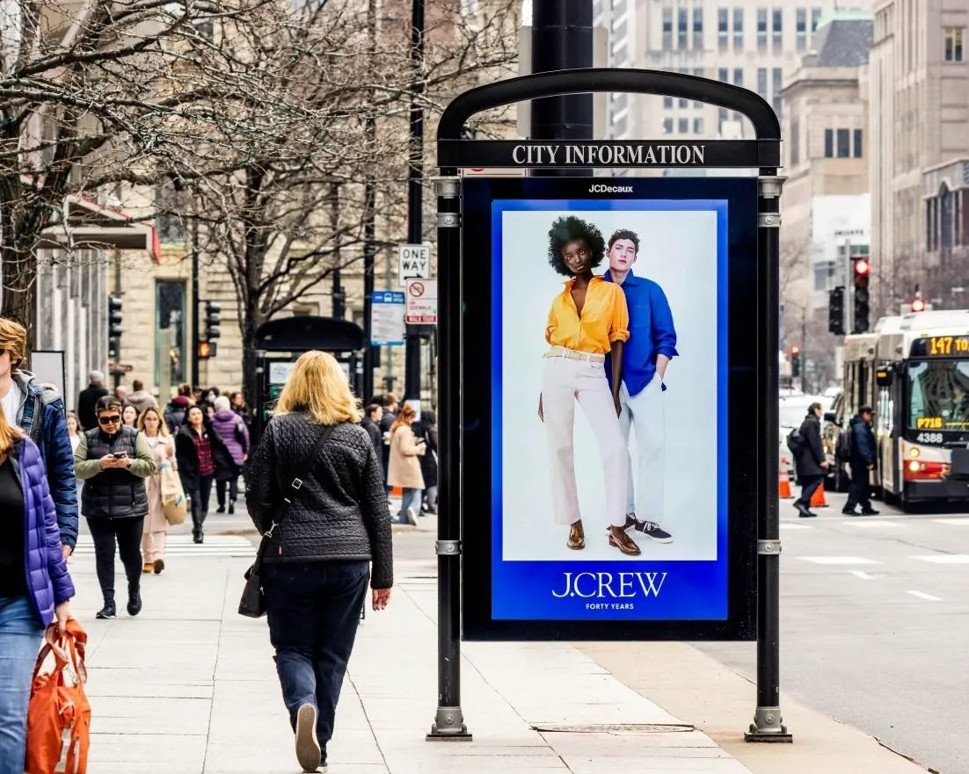
Solution
A-Unified Sharing Ads-Screen
JN provides a very suitable platform through 1 website Page working as public ads center ..
“Imagine the ads stand table in the street , converted to a web page having most business types“
Features:
Free as its digital , only special ads are paid .
Very fast access to page and inside the app looking for services using the post’s attributes method
Continuance :this DB is promoted by us forever. Users continue to read saved posts in an organized method regarding interests and desired niche
Joynet Marketing | Pitch deck
2025

Slide 22
Solution
B-Powerful Communication
JN provides a very suitable platform through website working as B2B , C2B ..
Simple , Fast and Effective
Features:
Users Communicates directly by business niche or provided service nature , targeting audience , SM groups ,communities pro networks are illustrated at one , were & read write done specifying service type and service-area.
Most of basic services included by type and category
All places supported related to country and city
Joynet Marketing | Pitch deck
2025

Slide 23
Example 3 “thousands of communications , one screen
Select none = All , combinations result in separate Niche [JN Network] ,
write to >> all sell/buy cars companies // technology inventors// Dentists in Jordan // any consultancy // talk as social to arts lovers
Business:
Sys Types
(7)
Invent - Manufacturing - Sell/Buy - Service -Information’s – Consultancy- SOCIAL
Sys Categories
(45)
Technology .., Health. Education. Transportations Arts Energy Social -services ..
Defined By user-specialty
Engineer… Developer .. Writer.. Dentist Doctor .. teacher …Cars(brands)
Area
USA INDIA ..Jordan….
Cities : defined by user ….
Joynet Marketing | Pitch deck
2025

Slide 24
Specialties/Cities
AI method
As a challenge , how user finds specific specialty were we have thousands for each category also huge number of cities and areas inside cities
In writing the post , user look in the drop down list which filled by other users , if he found a match he just select it , if not he add his own as new one but may , whatever ,
It depends on readers when applying the filter , as he select from same drop list , what he select , is what he found
Example , in example 3 , searching for cars , if writers 1 and 2 defined “cars A “ and writer 3 defined “cars A and B” , then if reader selected the choice “cars A” , he will not see writer 3 post , were its now in different network would be selected by interested users in cars A and B together ,and so on
Fab 2025
Joynet Marketing | Pitch deck

Slide 25
Benefits/Uses
Consider JN to work as a communication machine with basic types :
Central Advertisement for any business or service from home to large size were social marketing as a post- like provides this flexibility
Public Announcement : for Event organizing , Hot offers , News , Updates ,Sharing Projects ..etc.
Purchasing and inquiries : JN is suitable to communicate with a major community of certain business type /niche , adding a request for price post , members of this community can answer directly providing the required prices
Supply chain and affiliates networks could be used and applied easily over JN .
Example >>
Fav 2025
Joynet Marketing | Pitch deck

Slide 26
Example 3 purchasing process
A company is purchasing computers desktops So we are targeting selling computers companies
Just create the post including the computer specs or brand
Save the post with
Type = sell/buy
Category = technology , computers ,mobile
Specialty = Desktop ( can add the brand )
Now computer-companies reading this post will reply with prices .
Joynet Marketing | Pitch deck
Fab 2025

Slide 27
03-Product Overview
Joynet WIX –Website (registering soon as domain )
Visit , visitors wix report
The Complete solution is ready , DB is up and running through the website working as a mobile app same time , designed and hosted by WIX ,
The website having many features as :
Service Catalog , web app (page) to apply the marketing project Visit
Includes all related web app pages
Wix Groups for discussion with complete social features
E-store the joyshop , E-books shop , Shared gallery , file share
Support and AI CHAT features
Joynet Marketing | Pitch deck
Fab 2025

Slide 28
03-Product Overview
Joynet Order Online
Suggest to out customers as a business of any size , to provide online list for order by website visitors , This feature is technically supported in the App already as user can add photo gallery attached in the post .
Receiving approval from business and willing to corporate , we start this feature immediately were we expect it to have a good response after 4-6 months from official lunch .
Our target to get sales commission to every sale , almost 1-3%
Joynet Marketing | Pitch deck
Fab 2025

Slide 29
Service catalog -web App
Main parts of the APP
The creating post , Workspace page
User saved posts , My services page , Fav services page
The browsing DB page , presents the unified sharing screen
Full Tagging / Filtering pages , utilities for DB searching
Example : find all posts in health and education categories ..
Joynet Marketing | Pitch deck
Fab 2025

Slide 30
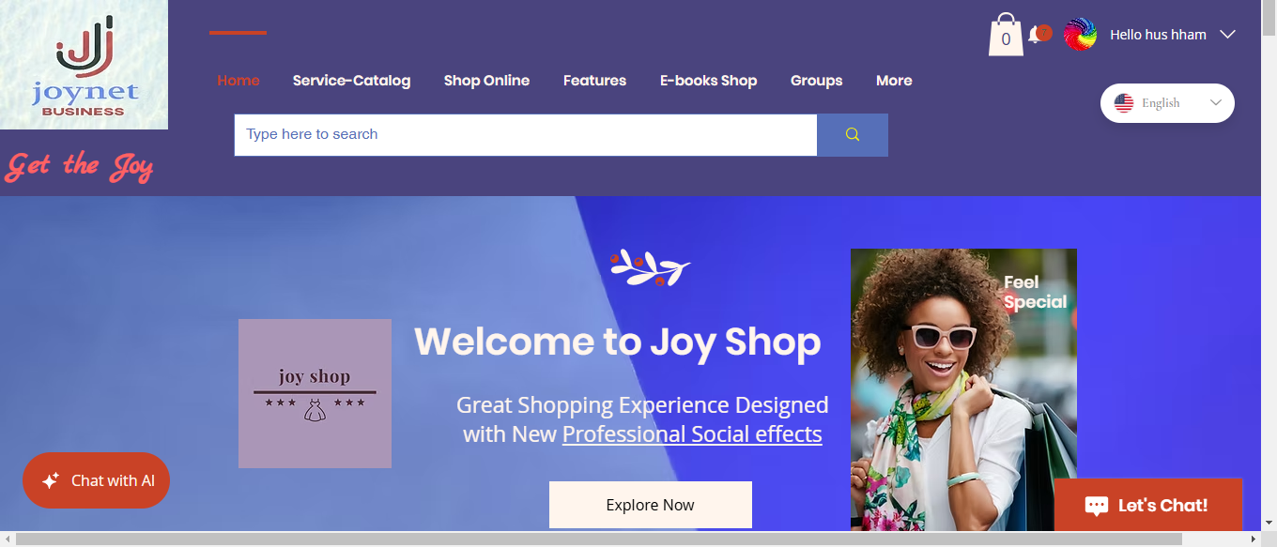
DEMO screen shots
Home screen
Joynet Marketing | Pitch deck
Fab 2025

Slide 31
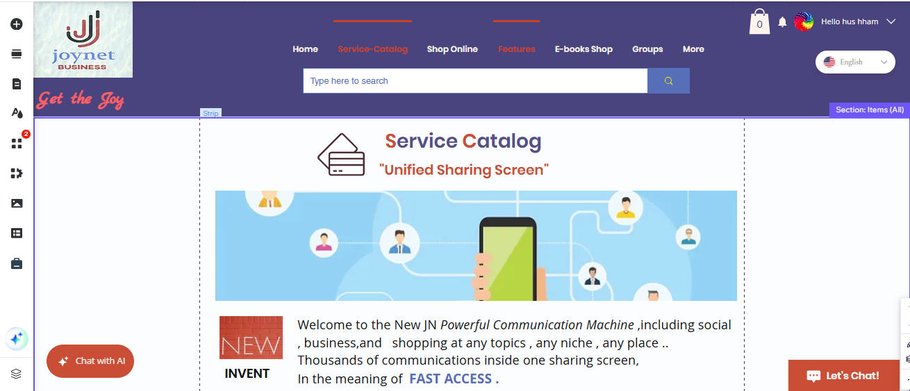
DEMO screen shots
Service Catalog
Joynet Marketing | Pitch deck
2025

Slide 32
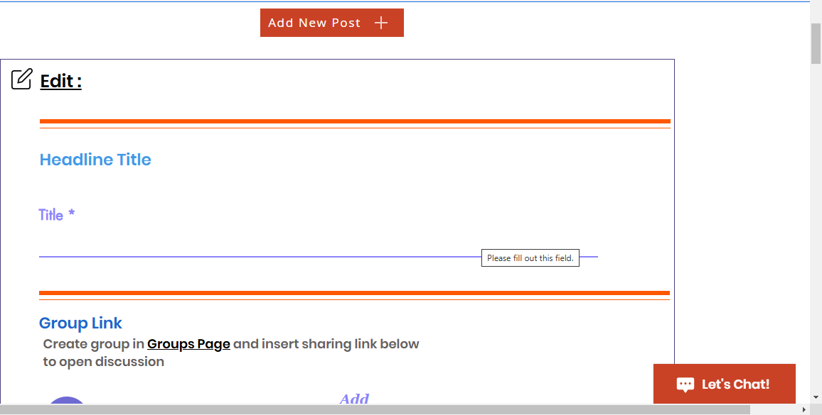
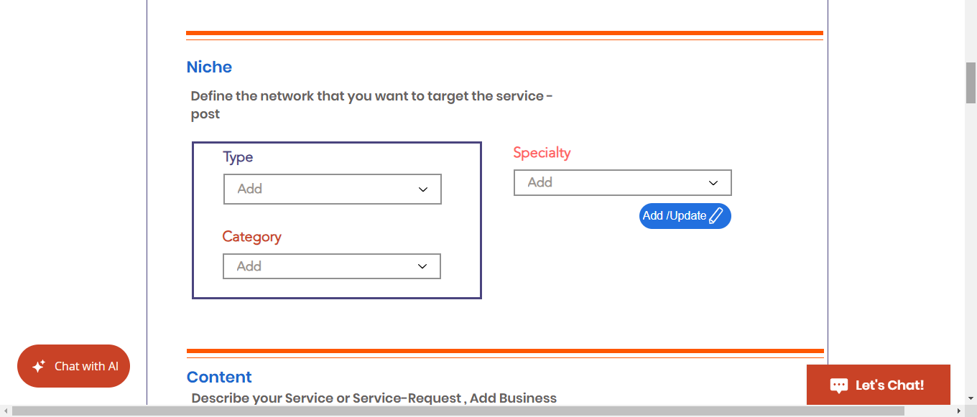
DEMO screenshots
Edit Post
Joynet Marketing | Pitch deck
Fab 2025

Slide 33
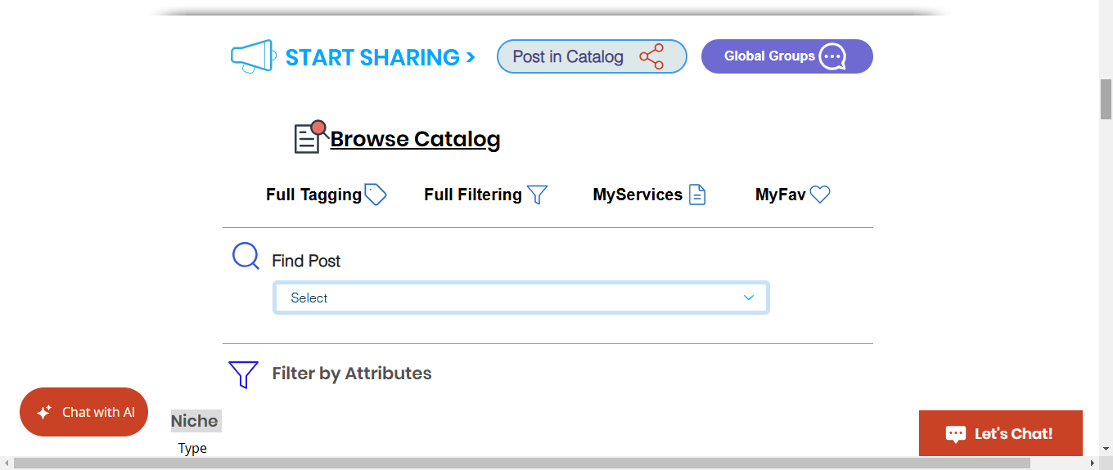
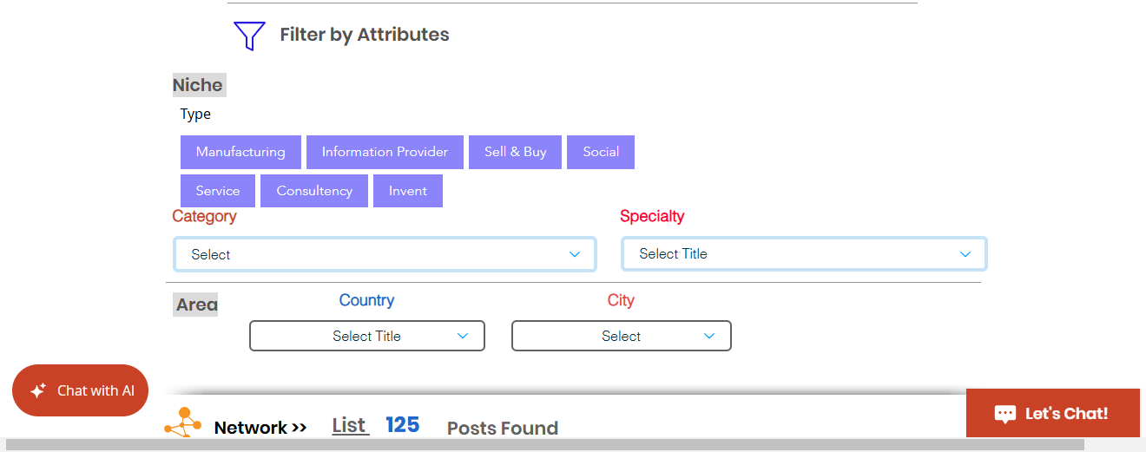
DEMO screen shots
Browsing Posts
Joynet Marketing | Pitch deck
Fab 2025

Slide 34
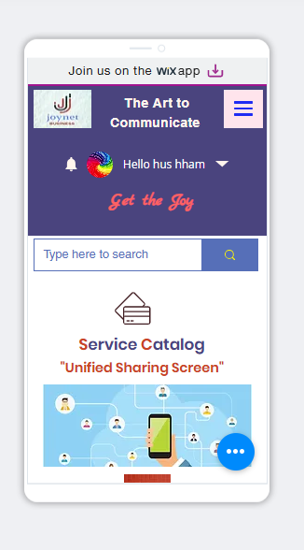
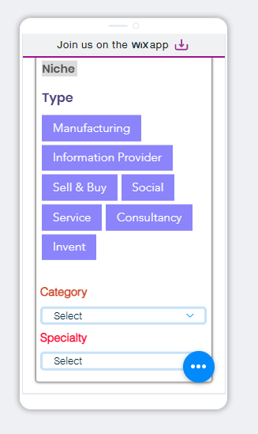
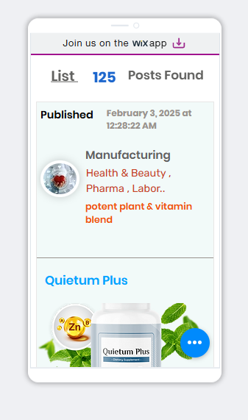
DEMO screen shots
Mobile
Joynet Marketing | Pitch deck
Fab 2025

Slide 35


Team
Eng. Husam Hamdeh
Nemer Alzuode
Founder ,computer engineer
h4joynet@gmaill.com
Co-founder, Financial Manager
nzuodezuode@gmail.com
Joynet Marketing | Pitch deck
Fab 2025

Slide 36
04-Market & Competition
Target Customers
General Society Customers : resolve daily issues ,get offers , shopping ,discounts , Persons over 20 years old
Idea , Prototype ,Startups (most concern) :
exchange information's , find solutions ,ask specialists , contact traders ..etc.
find key partners , funding , sharing business ideas
Small to Medium : selling and marketing etc.
Joynet Marketing | Pitch deck
Fab 2025

Slide 37
Competitors analysis
04-Business model
Main competitor found in locally is souq almaftouh sell/buy website , as selling is the common business module , but
Joynet considered to have other goals as communication business for marketing , with social environment , expected to be little away from direct comparison ,
Outside talking about social media , in JN we provide a free marketing , direct organized communication , JN is dedicated for business wise having its own technology ,and methods , although it uses social effects . In the end a business markets its services every were its being effective , and this is our target
Product vision | Pitch deck
2024

Slide 38
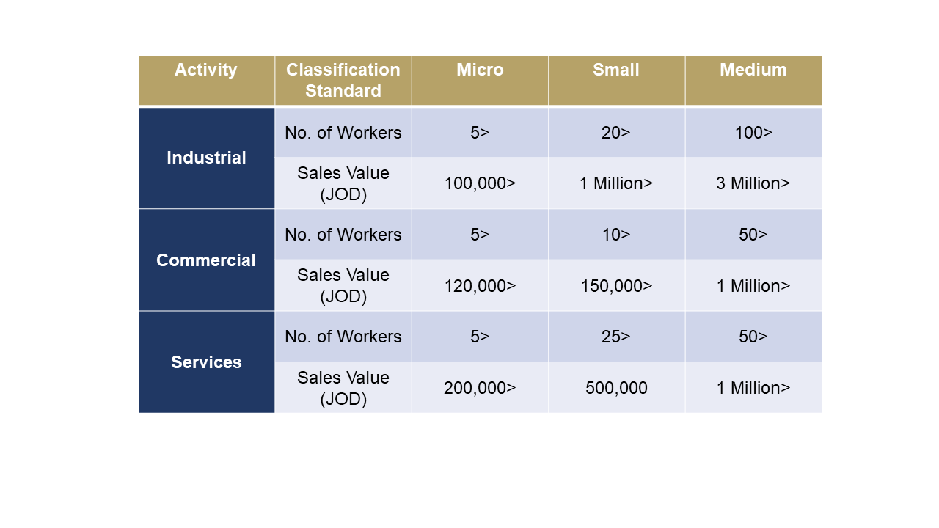
Market size (SME business ), Jordan chamber source
04-Business model
JN communication is important to all business in the long term upon its uses , but starting with SME in Jordan is most likely reasonable
Average of 500k (15% ~ 75k) business could be interesting in JN
Product vision | Pitch deck
2024

Slide 39
05-Business model
Business overview
> Joynet is social – business network designed for social marketing ,
Business depends on number of users , unique visitors , daily active users and so on , as its ready to go , remains the good marketing.
> As its new platform in the market , we stay in testing stage of the first 6 months , expecting huge number of participants ,
> Value of the platform itself increases with the growth of network users beyond the other methods of revenues streams .
Joynet Marketing | Pitch deck
Fab 2025

Slide 40
05-Business model
Business channels
Joynet would be be marketed though the following channels as the following :
Marketing professional company
Social media marketing by specialists .
Sales representatives to contact business inviting to participate in the platform, where they earn percentage of registered business for all its sales as long as sales lasts in the online order system
Joynet Marketing | Pitch deck
Fab 2025

Slide 41
04-Business model
Revenue Streams
Sources :
Paid ads put in certain places in the web site pages , specially of SC , depends on number of visitors / daily active users .
Special Ads , in the form of special –famous services list in the page as separated tab.
Subscriptions monthly / yearly as the website becomes very effective and useful for business regarding increasing sales .
Sales commissions : Business provides Online order List making online sales over joynet , will provide 1-3% sales commissions to every deal .
Google Adsense
Joynet Marketing | Pitch deck
Fab 2025

Slide 42
04-Business model
Revenue Streams
Expected after 4-6 months from start point were
Source | time period | Expected
Number of users | first year | 100-200 K
Promotions/Special ads | After 6 months from start point | Daily 100 ads of 20 $ each = 2k $ daily
Subscriptions for hosted Services | After 6 months from start point | 1000 participants of 50 $ yearly = 50k $
Online order commissions Percentage of sales (1-3)% of each sale | After 4 months from start point | For 30 participants business monthly Average 1 sales daily = 30 sales with every sale average = 10 JDs Average Sales size = 300 JDs daily 3% (300) = 30 JDs daily Around 1000 JDs monthly
Joynet Marketing | Pitch deck
Fab 2025

Slide 43
04-Business model
Key partners
Outsourcing web design , developers as needed
Legal issues company
Accounting /tax specialists
Joynet Marketing | Pitch deck
Fab 2025

Slide 44
04-Business model
Cost structure
The main two important processes to keep the Business going is :
Hosting the Website – WIX
Marketing
Developing and adding more features
Joynet Marketing | Pitch deck
Fab 2025

Slide 45
04-Business model
>> Initial Cost
Item | Expected cost | time period
website hosting | 30-50 $ | monthly
Marketing initial | 20K $ | 4 months
Office and rent | 10k $ | 6 months
Total initial cost | around 30K $
Joynet Marketing | Pitch deck
Fab 2025

Slide 46
Thanks!
Do you have any questions?
H4joynet@gmail.com
+962798300720
Joynet
Joyshop project
Product vision | Pitch deck
2024

